Slide 1
DATA BACKUP AND RESTORING USING RPA
Team Members
1. Piraivendhan K [711715104044]
2. Revathi N [711715104049]
3. Sreerag R [711715104057]
Faculty guide : Industrial guide :
Name: Mr.Nandakumar S D Name: Mr. Jayadheep C
Assistant professor RPA Developer
Department of CSE KGiSL GSS
Department of CSE, KGiSL Institute of Technology, Coimbatore

Slide 2
Abstract
Data backup is the process of backing up the data, refers to copying the data into an archive file of computer data so it may be used to restore the original after a data loss event. Backups have two distinct purposes. The primary purpose is to recover data after its loss, be it by data deletion or corruption.Data loss can be a common experience of computer users while transferring the data. The secondary purpose of backups is to recover data from an earlier time, according to a user-defined data retention policy, typically configured within a backup application for how long copies of data are required.These processes can be fully automated with the RPA solutions by providing them with the required credentials, source and destination details for the whole task to be automated. Monitoring the whole process can also be handled by the RPA.

Slide 3
Area Introduction-Existing system
➔ RPA stands for Robotic Process Automation is the application of technology that allows employees in a company to configure computer software or a “robot” to capture and interpret existing applications for processing a transaction, manipulating data, triggering responses and communicating with other digital systems. ➔ In the existing system, the data backup is done using the tape method. If the tape becomes older, the backup process gets interrupted. ➔ The existing system is less secure as many data are lost during the backup process from the system.
Department of CSE, KGiSL Institute of Technology, Coimbatore

Slide 4
Proposed System ➔ Advantages over existing methods *Upgrades underlying applications and services *It can help scale resources and meet the need of growing business data *Boost efficiency and effectiveness of the system ➔ Future Enhancements *Security is enhanced
Department of CSE, KGiSL Institute of Technology, Coimbatore

Slide 5
Software Requirement Specification
Software Interface
Operating system: Windows 10
IDE: UiPath Studio
Hardware Interface
Processor: Intel®core™i3-6006U CPU @ 2.00GHz 2.00GHz
Memory: 4.00 GB RAM
Communication Interface
Windows

Slide 6
Literature Review
Drawbacks of existing methods
Data sensitivity
Security
Application interoperability
Less mobility
References
R.S.Suguna and A. Suhasini, "Overview of data backup and disaster recovery in cloud," International Conference on Information Communication and Embedded Systems (ICICES2014), Chennai, 2014, pp. 1-7.
doi: 10.1109/ICICES.2014.7033804
https://orchestrator.uipath.com/v2016.2/docs/backing-up
https://orchestrator.uipath.com/docs/about-physical-deployment
https://orchestrator.uipath.com/docs/disaster-recovery-activepassive
Department of CSE, KGiSL Institute of Technology, Coimbatore

Slide 7
Introduction
In our proposed system, the data from the different sources are collected on a daily basis. The bot will be trained to the process of extraction of data based on condition. The process will be idle until the admin triggers the bot using orchestrator. After the triggering factor, the files from the different sources are collected as a master file. The backup process is done for the master file.

Slide 8
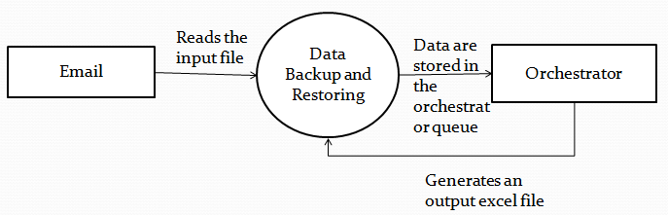
Architectural Design DFD Diagram
Data Flow Diagram Level 0

Slide 9
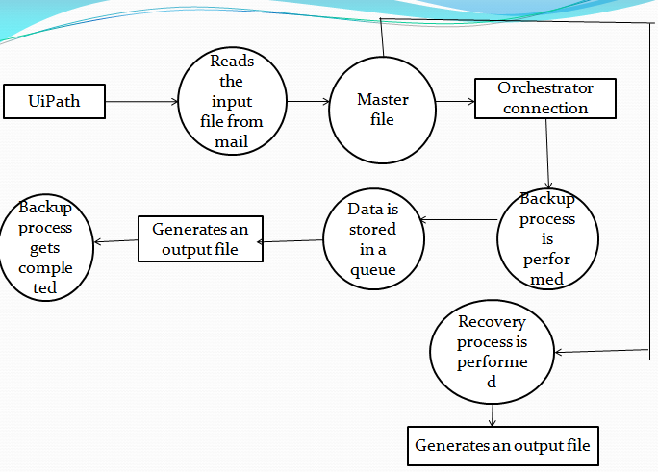
Data Flow Diagram-Level 1

Slide 10
Module Splitup Module 1: Separating the data from the data set Module 2: Backup process Module 3: Restoring process Module 4: Orchestrator connection
Department of CSE, KGiSL Institute of Technology, Coimbatore

Slide 11
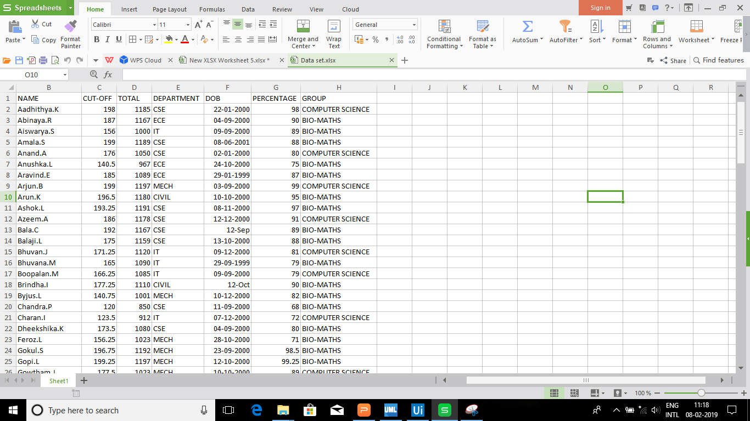
Screen shots of modules under progress. Module-1
Department of CSE, KGiSL Institute of Technology, Coimbatore

Slide 12
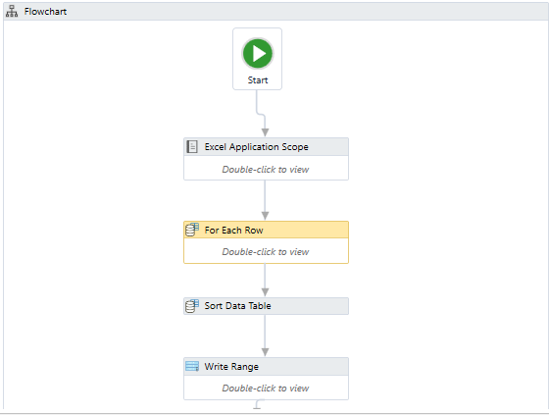
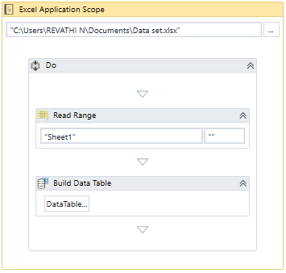
Screen shots of modules under progress. Module-1

Slide 13
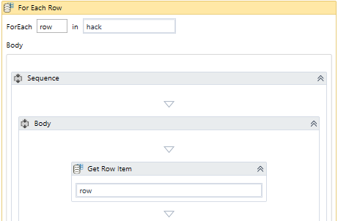
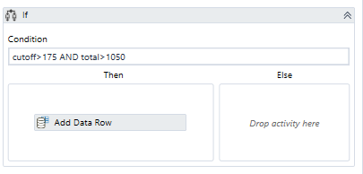
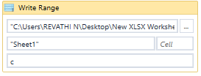
Screen shots of modules under progress. Module-1

Slide 14
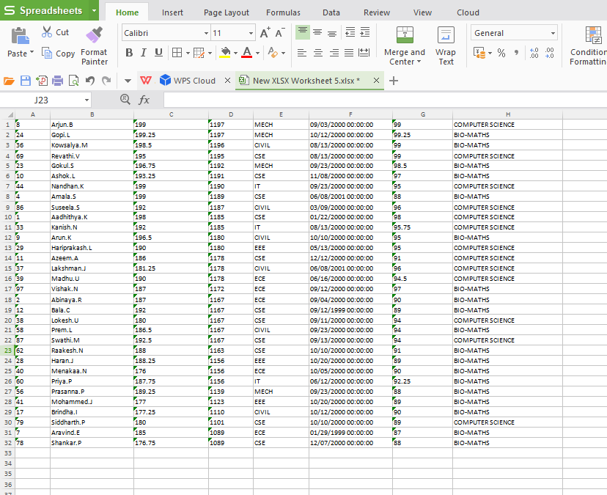
Screen shots of modules under progress.

Slide 15
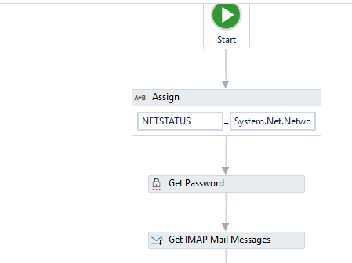
Snapshots

Slide 16
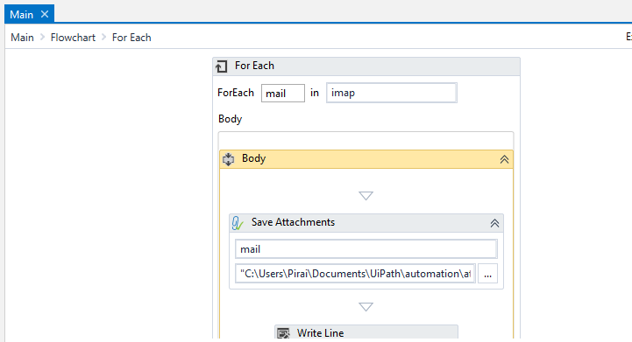
Snapshots

Slide 17
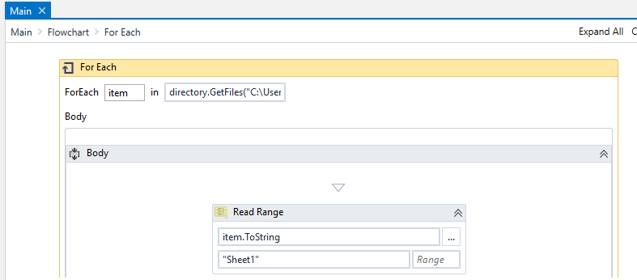
Snapshots

Slide 18
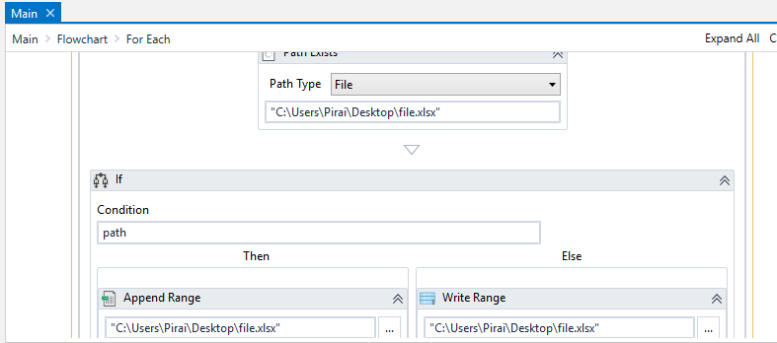
Snapshots

Slide 19
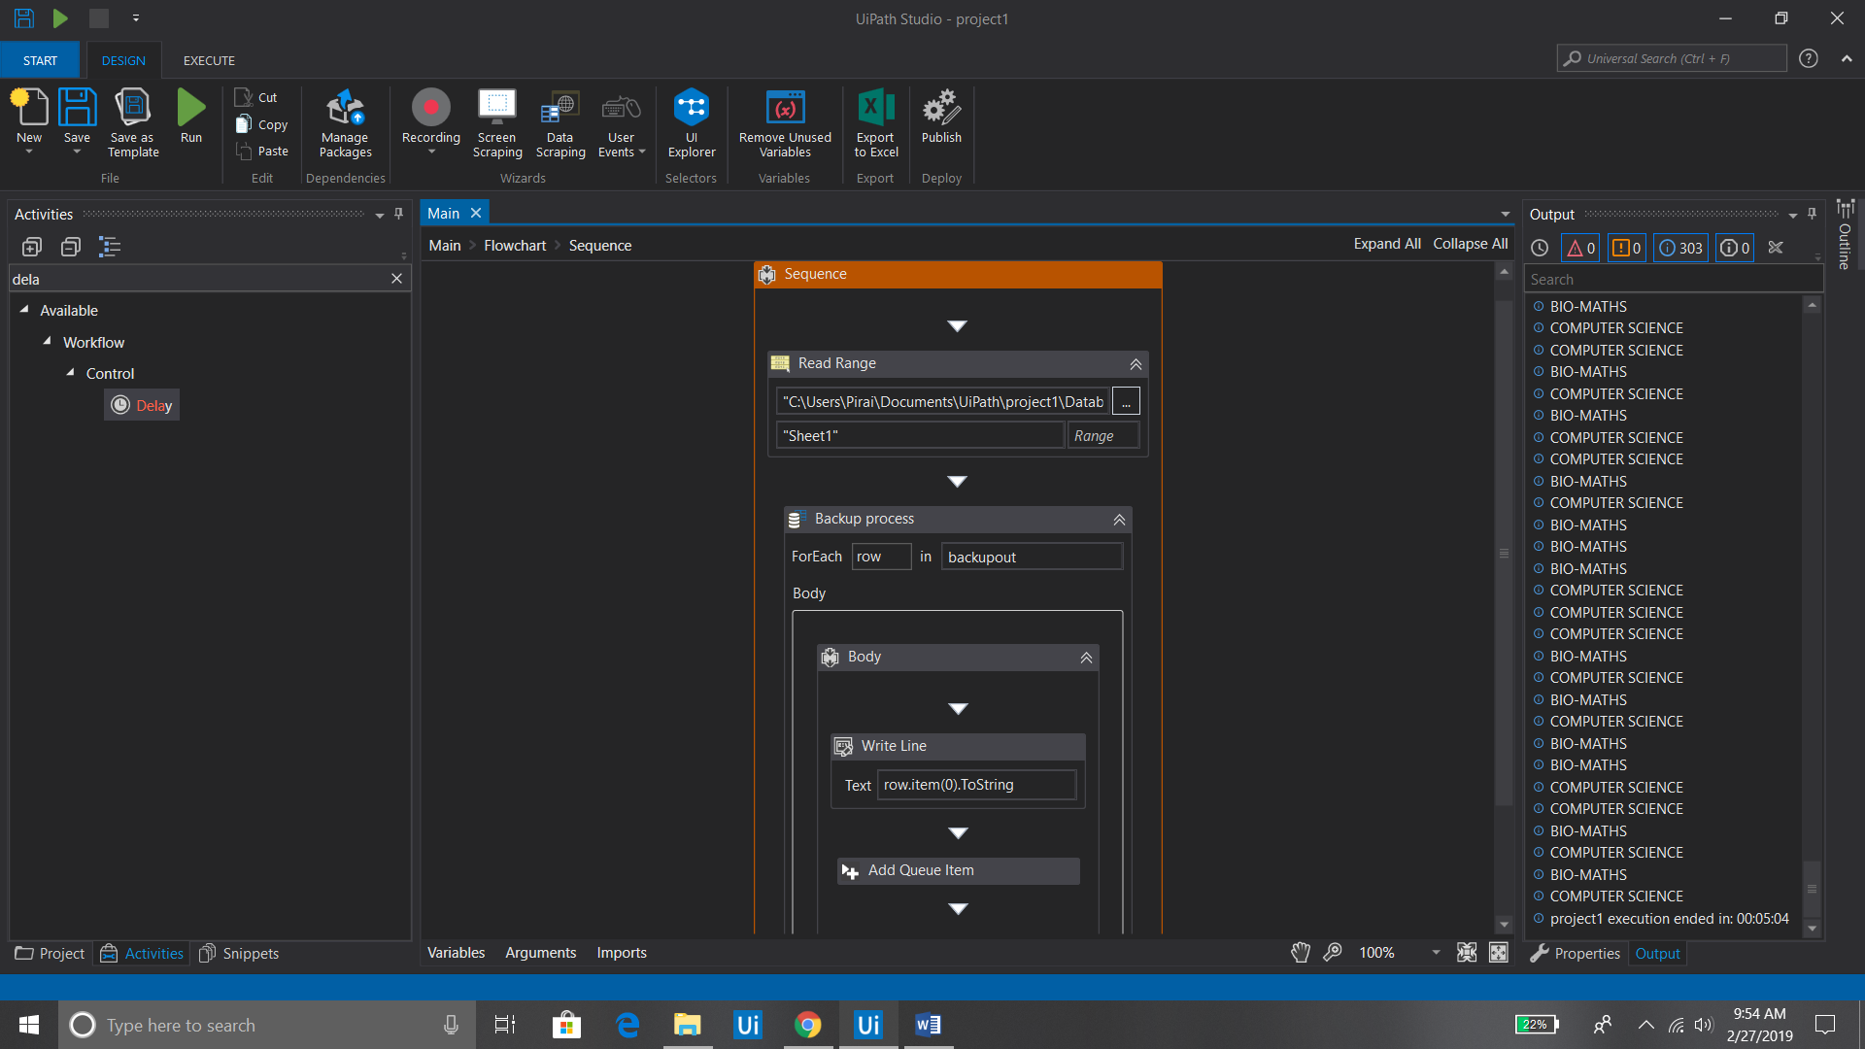
Snapshots

Slide 20
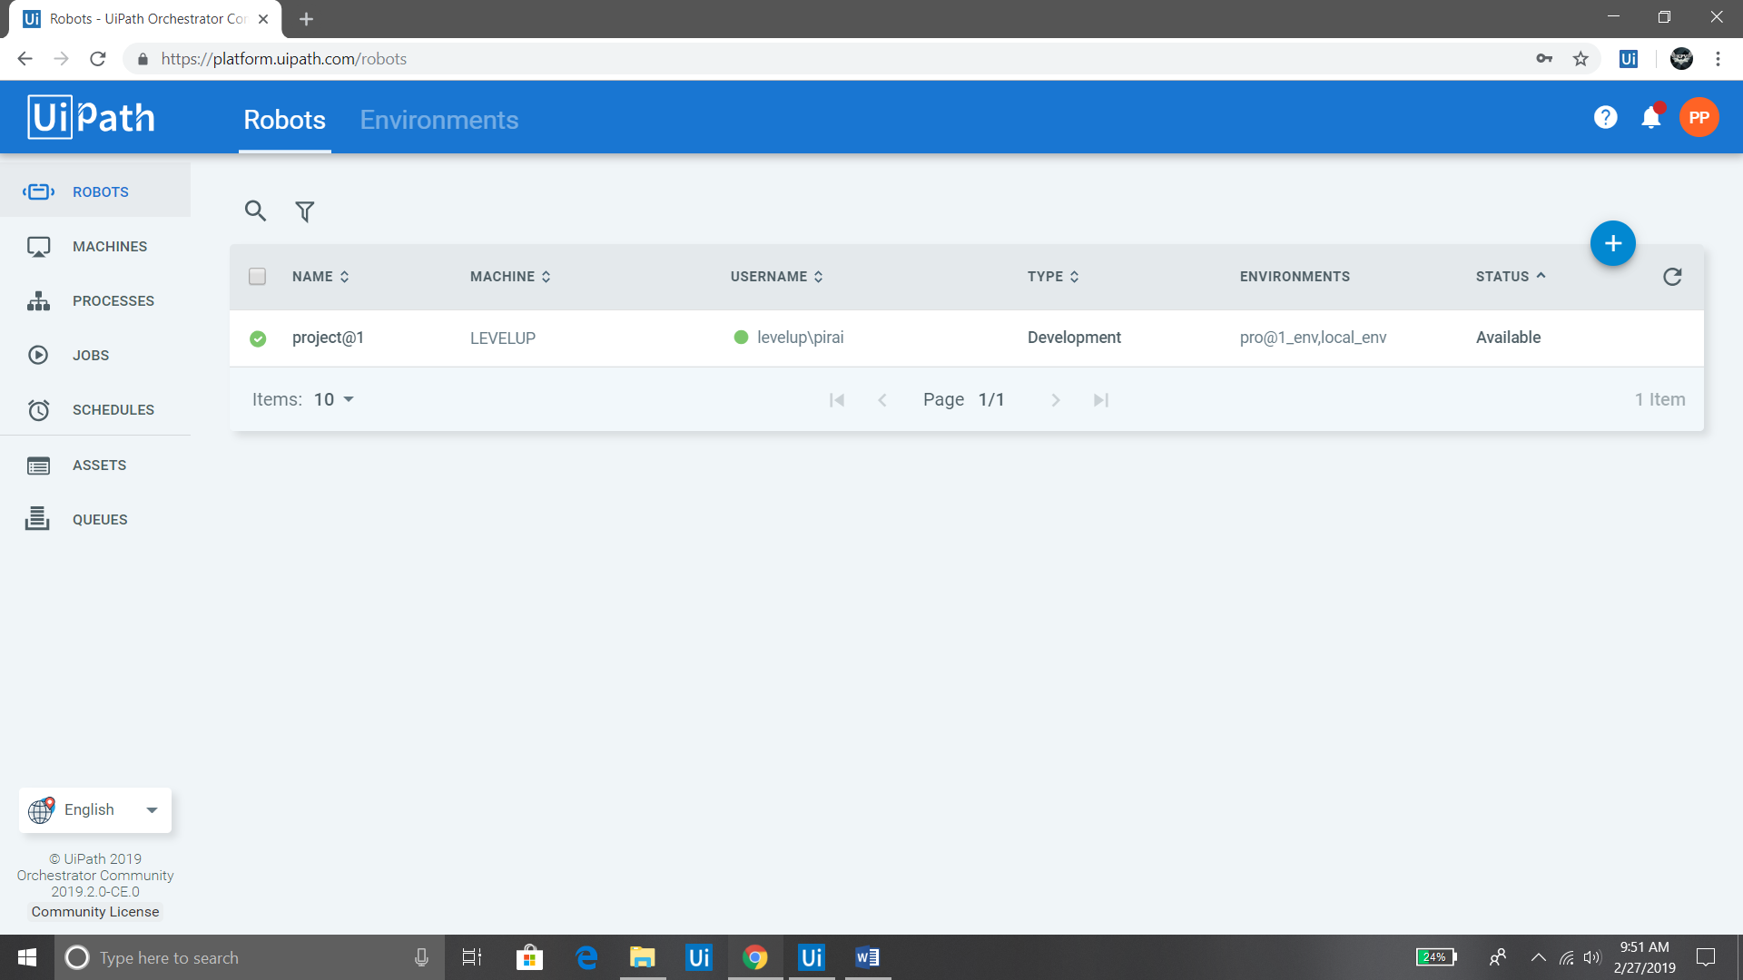
Snapshots

Slide 21
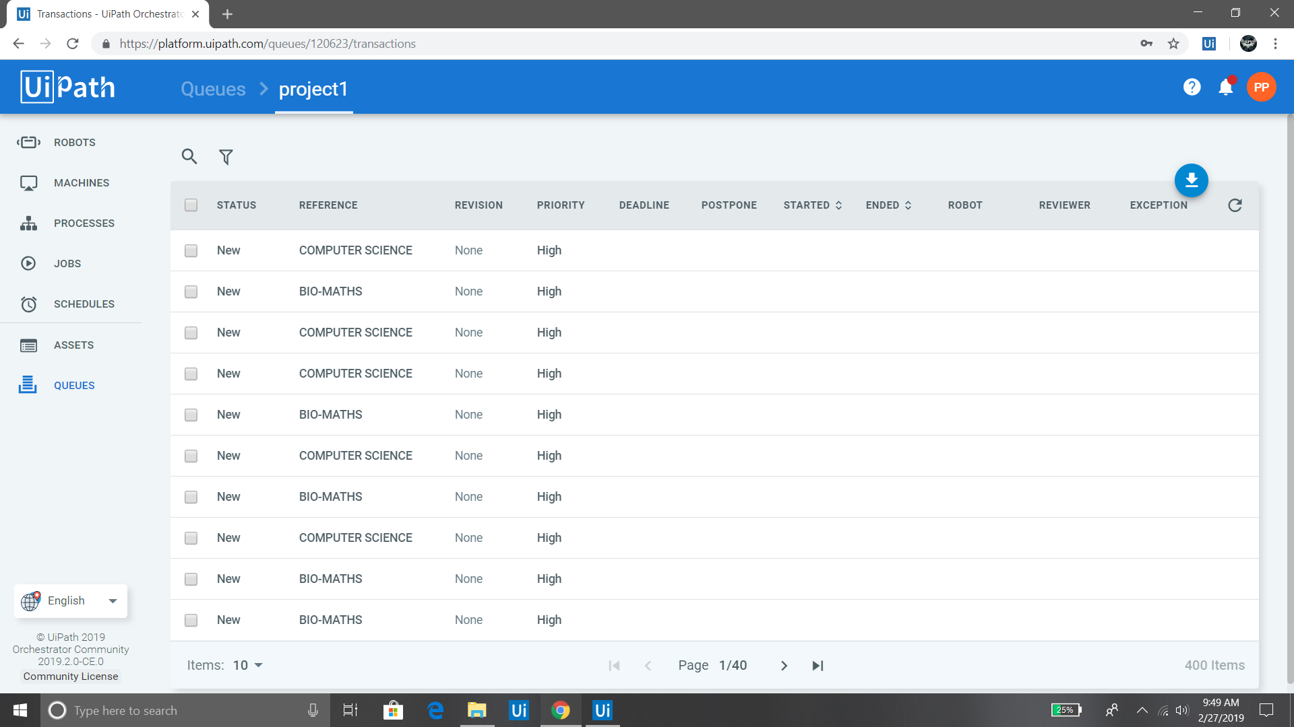
Snapshots

Slide 22
Conclusion
The main aim of this paper is to provide the essential information about the data backup and the recovery process. The key idea we have applied here is the automation. Automation we have applied does not require any manual work in order to manage the data during the process. It supports large volume of data to backup and because of the automation process, the performance of the system does not affected by the internal process. It helps in scaling the resources and meet the need of growing business data. It requires only short time for the whole automation process which is very much beneficial when compared to the manual process. The security is enhanced so that the data cannot be lost during the process. The inter operability speed of the system gets improved by our proposed system, so the efficiency gets benefited.

Slide 23
Thank You
Department of CSE, KGiSL Institute of Technology, Coimbatore

